Slide 1
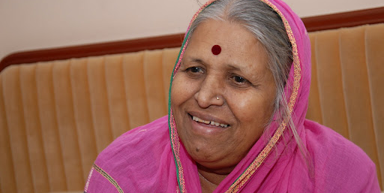

SINDHUTAI SAPKAL : MOTHER OF ORPHANS
Presented by –
Vasu Kalariya
PE29-1032180772

Slide 2

Contents
Introduction
Early life and education
Marriage and early work
Later work
Operating organisations
Awards
MY Learnings

Slide 3
INTRODUCTION
Sou. Sindhutai Sapkal and also known as “Mother of Orphans” .
She is an Indian Social Worker and Social activist known particularly for her work for raising orphan children
She loves being called “Mai”.
she fought against the exploitation of local women, who collected cow dung, by the forests department and landlords

Slide 4
More about Sindhutai…
Sindhutai Sapkal was born on 14 November 1948 in a cattle grazing family in Maharashtra’s Wardha district
Being an unwanted child, she was referred to as Chindhi (Marathi for "torn piece of cloth")
At the age of twelve, Sapkal was married to a man twenty years her senior in Wardha District
She had a One Biological Girl .

Slide 5
Early Life and Education
She was born on 14 November 1948 at Pimpri Meghe village in Wardha district to Abhimanji Sathe, a cowherd by profession
Her father was keen on educating Sindhutai, much against the wishes of her mother
Abhimanji used to send her to school under the pretext of cattle grazing
Abject poverty, family responsibilities and an early marriage forced her to quit formal education after she passed 4th grade.

Slide 6
MARRIAGE AND EARLY WORK
At the age of 10, she got married to Shrihari Sapkal alias Harbaji, a 30-year-old cowherd from Navargaon village in Wardha District.
She bore 3 sons by the time she turned 20 and also . She gave birth to a baby girl on 14 October 1973 in a cow shelter outside their house
In the process, she realised that there are so many children abandoned by their parents and she adopted them as her own and started begging even more vigorously to feed them.
She decided to become a mother to anyone and everyone who came across to her as an orphan

Slide 7
LATER WORK..
She has devoted her entire life for orphan.
As a result she is fondly called 'Mai'(mother). She has nurtured over 1050 orphaned children.
Many of the children whom she adopted are well-educated lawyers and doctors, and some, including her biological daughter, are running their own independent orphanages.
She has been honoured with over 273 awards for her dedication and work.
At the age of 80, her husband came back to her apologetically.

Slide 8
A Marathi film 'Mee Sindhutai Sapkal' released in 2010, is a biopic inspired by the true story of Sindhutai Sapkal.
When she met Chhedilal Gupta, the then minister of forests. He agreed that the villagers should not to be displaced before the government had made appropriate arrangements at alternative sites.
When Prime Minister Indira Gandhi arrived to inaugurate the tiger project, Sindhutai showed her photographs of an Adivasi who had lost his eyes to a wild bear.
And successfully sanctioned compensation.

Slide 9
OPERATING ORGANIZATIONS
Sanmati Bal Niketan, Bhelhekar Vasti, Hadapsar,Pune.
Mamata Bal Sadan, Kumbharvalan, Saswad.
Mai's Ashram Chikhaldara, Amravati.
Abhiman Bal Bhavan, Wardha.
Gangadharbaba Chhatralaya, Guha.
Saptsindhu' Mahila Adhar, Balsangopan Aani Shiksha Sanstha, Pune.

Slide 10
AWARDS
1992
Leading Social Contributor Award.
2008
Woman of the Year Award, given by daily marathi newspaper Loksatta
2010
Ahilyabai Holkar Award.
2013
The National Award for Iconic Mother.
2013
Mother Teresa Awards for Social Justice.
2014
BASAVA BHUSANA PURASKAR-2014,Awarded.
2015
Ahmadiyya Muslim Peace Prize for the year 2014
Padmashri award
2021

Slide 11
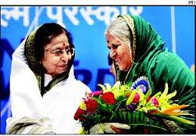
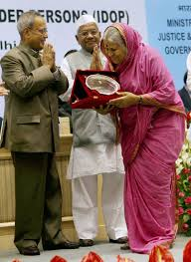
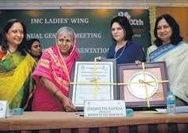
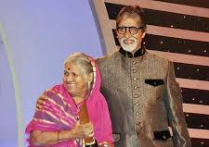
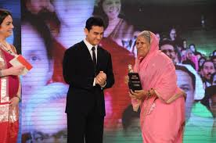
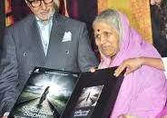
SOME MOMENTS…

Slide 12
MY LEARNINGS
Transforming Our Struggles Into Strength
she is highly passionate about her life’s mission to nurture and raise the orphans.
she sings and speaks eloquently and touches everyone’s heart.
Values: compassion, hard work, humility, persistence against all odds, consistency, forgiveness, sincerity, honesty, self-confidence, impartiality, sacrifice….the list goes on.
Responsibility: she took serious responsibility for herself, her biological child and thousands of abandoned orphans

Slide 13
Thank You

